Slide 1
London Crime Data Intermediate Presentation
Fabian Sperrle, Fabio Brückel, Matthias Miller, Matthias Kraus

Slide 2
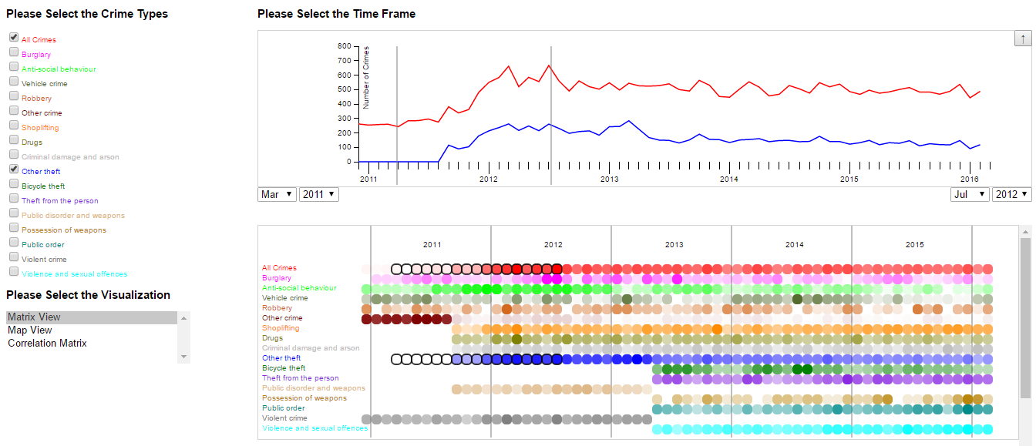
Interaction Workflow
Question1: Where were the highest number of shoplifting in London City in 2012?
Select Crime Type(s)
Select Time Frame
Select Visualization
User Interface

Slide 3
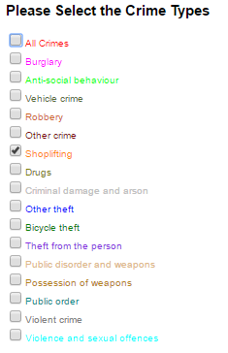
Select Crime Type(s)
Question1: Where were the highest number of shoplifting in London City in 2012?

Slide 4
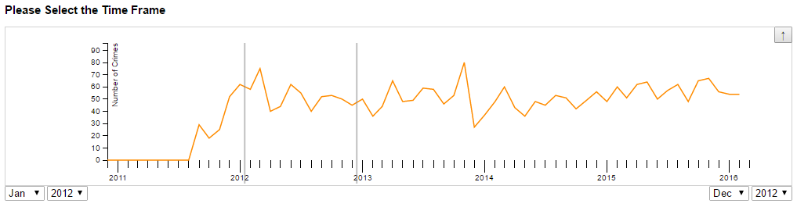
Select Timeframe
Question1: Where were the highest number of shoplifting in London City in 2012?

Slide 5

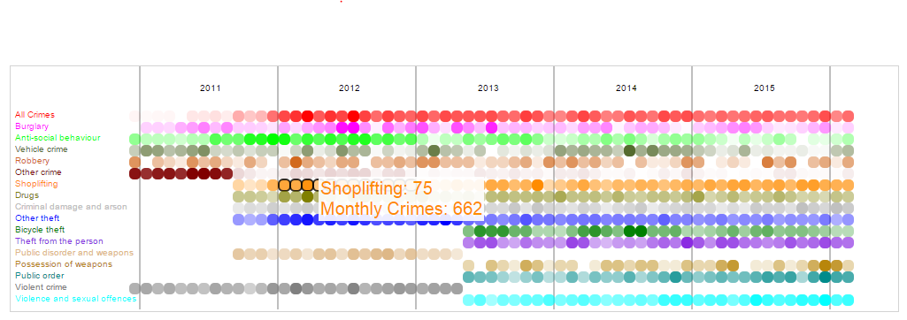
Select Visualization – Matrix View
Question1: Where were the highest number of shoplifting in London City in 2012?

Slide 6
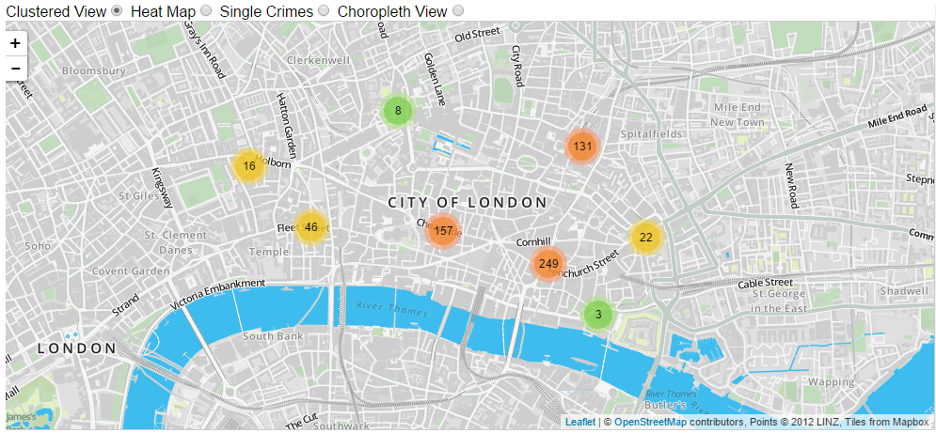
Select Visualization – Map View
Question1: Where were the highest number of shoplifting in London City in 2012?

Slide 7
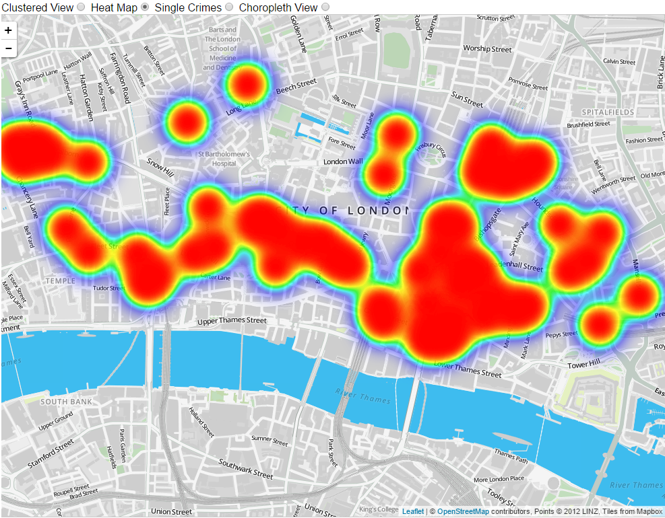
Select Visualization – Heat Map
Question1: Where were the highest number of shoplifting in London City in 2012?

Slide 8
Future Work: Visualizations
Solved crimes rate over time
Choropleth map
Improve Heat map
Aggregation of crimes in a specific area
Crime Detail Views (Chloropleth, Tooltips)

Slide 9
Thank you for your attention!

Slide 10
Possible questions to analyze
Which area has the highest crime risk?
Gang activities / ghetto development over years
Crime rates per city district over time
Shifts over time
In what areas is a crime offender most likely caught and prosecuted?
Differences summer/winter and during special times (christmas)

